Slide 1
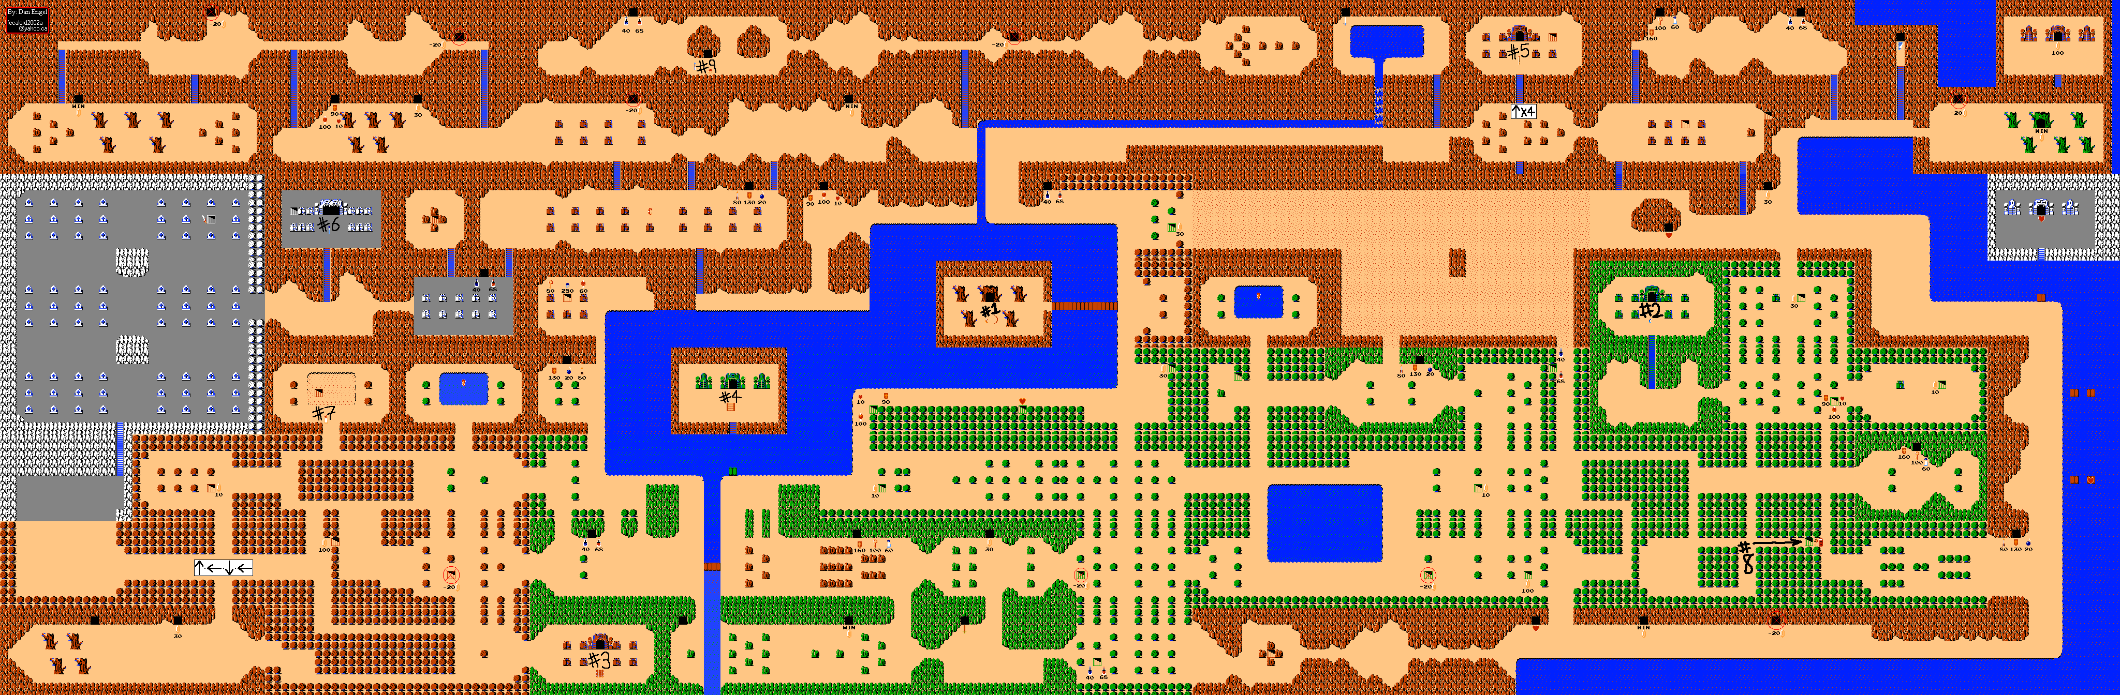
CSE 219 – Computer Science III
Graphics and GUIs
Legend of Zelda, by Nintendo, released 1987

Slide 2
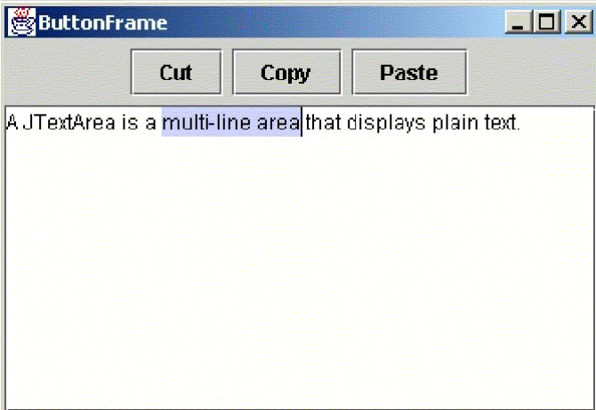
So where were we?
We learned to use Swing to:
  create a window (JFrame)
  arrange components in our window
  react to user interactions
Note: so far, we are only using pre-made components
  JButton, JTextField, etc.
  these have pre-programmed options for:
    rendering
    behavior

Slide 3

What’s next?
How do we render the game?
How do we listen for mouse interactions on game?

Slide 4
Where will be draw?
On a JPanel
Why?
  because they’re blank canvases
To do this:
  define your own JPanel
  customize how its rendered

Slide 5
Drawing on a JPanel
Define a class that extends JPanel
  include necessary instance variables
    would have data about the items to be drawn
    images, locations, etc.
  override the paintComponent method
    inherited from JComponent
    do all image (and shape & text) rendering inside
paintComponent
  called on all GUI components
  we can plug in our own custom rendering

Slide 6
Panel Rendering
public class MyPanel extends JPanel
{
// INSTANCE VARIABLES CONTAINING
// EVERYTHING TO BE RENDERED
public void paintComponent(Graphics g)
{
// code for drawing will go here
}
}

Slide 7
public void paintComponent(Graphics g)
Never call this method yourself
You will be tempted to.
Instead, to redraw your panel
  call repaint on your panel object (
    in response to events
    or in response to a timer (for animation)

Slide 8
An approach to defining paintComponent
Anticipate changes in what gets rendered
  think dynamically
Render according to instance variables
Carefully map out your logic
  remember: design, design, design

Slide 9
Graphics
Stores settings for rendering:
  current Color to use (text and shapes)
  current Font to use (text)
  current Stroke (line thickness) to use
Has methods for rendering
  images, rectangles, ovals, polygons, lines, and text
Specify all locations and sizes in pixels
  (0, 0) coordinate is top-left corner of panel

Slide 10
Some Methods of the Graphics Class
To change rendering settings:
  setColor
  setFont
  setStroke
To render:
  drawPolygon
  drawRect
  drawImage
  drawOval
  drawString
  drawLine
  fillPolygon
  fillRect
  fillImage
  fillOval

Slide 11
Colors
setColor
  select a color used for all subsequent drawing. Ex:
13 Standard Colors:
  black, blue, cyan, darkGray, gray, green, lightGray, magenta, orange, pink, red, white, yellow
  Ex: g.setColor(Color.red);
More than 4 billion custom colors:
  Color(int red, int green, int blue)
  Red, blue, and green are values from 0-255
  Ex: g.setColor(new Color(255, 0, 0));

Slide 12
How can we respond to mouse clicks on our panel?
Define our own event handler (a MouseListener)
  make it an inner class of panel
Respond inside one of 5 methods:
  mousePressed
  mouseReleased
  mouseClicked
  mouseEntered
  mouseExited
For your panel:
  declare your handler as an instance variable
  construct your handler
  register your handler with the panel

Slide 13
How can we respond to mouse dragging on our panel?
Define our own event handler (a MouseMotionListener)
Respond inside one of 2 methods:
  mouseDragged
  mouseMoved
For your panel:
  declare your handler as an instance variable
  construct your handler
  register your handler with the panel

Slide 14
Example: mixing Graphics & Events
Create a GUI with a panel on which we will render lots of random irregular pentagons
  random shape and color
When the user double clicks on the panel
  will clear panel
Wherever the user drags the mouse on the panel:
  more pentagons will be added

Slide 15
public class PentaFrame extends JFrame
{
private PentaPanel pentaPanel;
public PentaFrame()
{
super("Penta Frame");
setExtendedState(MAXIMIZED_BOTH);
setDefaultCloseOperation(EXIT_ON_CLOSE);
layoutGUI();
}
public void layoutGUI()
{
pentaPanel = new PentaPanel();
this.add(pentaPanel, BorderLayout.CENTER);
}
public static void main(String[] args)
{
PentaFrame frame = new PentaFrame();
frame.setVisible(true);
}
}

Slide 16
public class PentaPanel extends JPanel
{
// EVENT HANDLERS
private MouseHandler mouseHandler;
private MouseMotionHandler mouseMotionHandler;
// WE'LL USE THESE VECTORS FOR STORING THE VERTICES
// AND COLORS OF OUR PENTAGONS
private Vector<int[]> xPoints;
private Vector<int[]> yPoints;
private Vector<Color> colors;

Slide 17
public PentaPanel()
{
// AND OUR PENTAGRAM VERTEX ARRAYS
xPoints = new Vector<int[]>();
yPoints = new Vector<int[]>();
colors = new Vector<Color>();
// LET'S LISTEN FOR MOUSE CLICKS
// AND DRAGGING ON THE PANEL
mouseHandler = new MouseHandler();
this.addMouseListener(mouseHandler);
mouseMotionHandler = new MouseMotionHandler();
this.addMouseMotionListener(mouseMotionHandler);
}

Slide 18
public void paintComponent(Graphics g)
{
super.paintComponent(g);
// DRAW ALL THE PENTAGONS
for (int i = 0; i < xPoints.size(); i++)
{
int[] xVertices = xPoints.get(i);
int[] yVertices = yPoints.get(i);
Color color = colors.get(i);
g.setColor(color);
g.fillPolygon(xVertices, yVertices, 5);
g.setColor(Color.black);
g.drawPolygon(xVertices, yVertices, 5);
}
}

Slide 19
class MouseHandler extends MouseAdapter
{
public void mouseClicked(MouseEvent me)
{
if (me.getClickCount() == 2)
{
xPoints.clear();
yPoints.clear();
colors.clear();
repaint();
}
}
}

Slide 20
class MouseMotionHandler extends MouseMotionAdapter
{
public void mouseDragged(MouseEvent me)
{
// THE LOCATION OF WHERE WE'RE DRAGGING THE MOUSE
int x = me.getX();
int y = me.getY();
// THESE WILL BE THE VERTICES
int[] xs = new int[5];
int[] ys = new int[5];
// TOP CENTER POINT
xs[0] = x;
ys[0] = y - (int)(Math.random() * 20) - 1;
// TOP-RIGHT POINT
xs[1] = x + (int)(Math.random() * 15) + 1;
ys[1] = y - (int)(Math.random() * 10) – 1;

Slide 21
// BOTTOM-RIGHT POINT
xs[2] = x + (int)(Math.random() * 10) + 1;
ys[2] = y + (int)(Math.random() * 15) + 1;
// BOTTOM-LEFT POINT
xs[3] = x - (int)(Math.random() * 10) - 1;
ys[3] = y + (int)(Math.random() * 15) + 1;
// TOP-LEFT POINT
xs[4] = x - (int)(Math.random() * 15) - 1;
ys[4] = y - (int)(Math.random() * 10) - 1;
xPoints.add(xs);
yPoints.add(ys);
int r = (int)(Math.random() * 256);
int g = (int)(Math.random() * 256);
int b = (int)(Math.random() * 256);
colors.add(new Color(r,g,b));
repaint();
}
}
}

Slide 22
